Slide 1
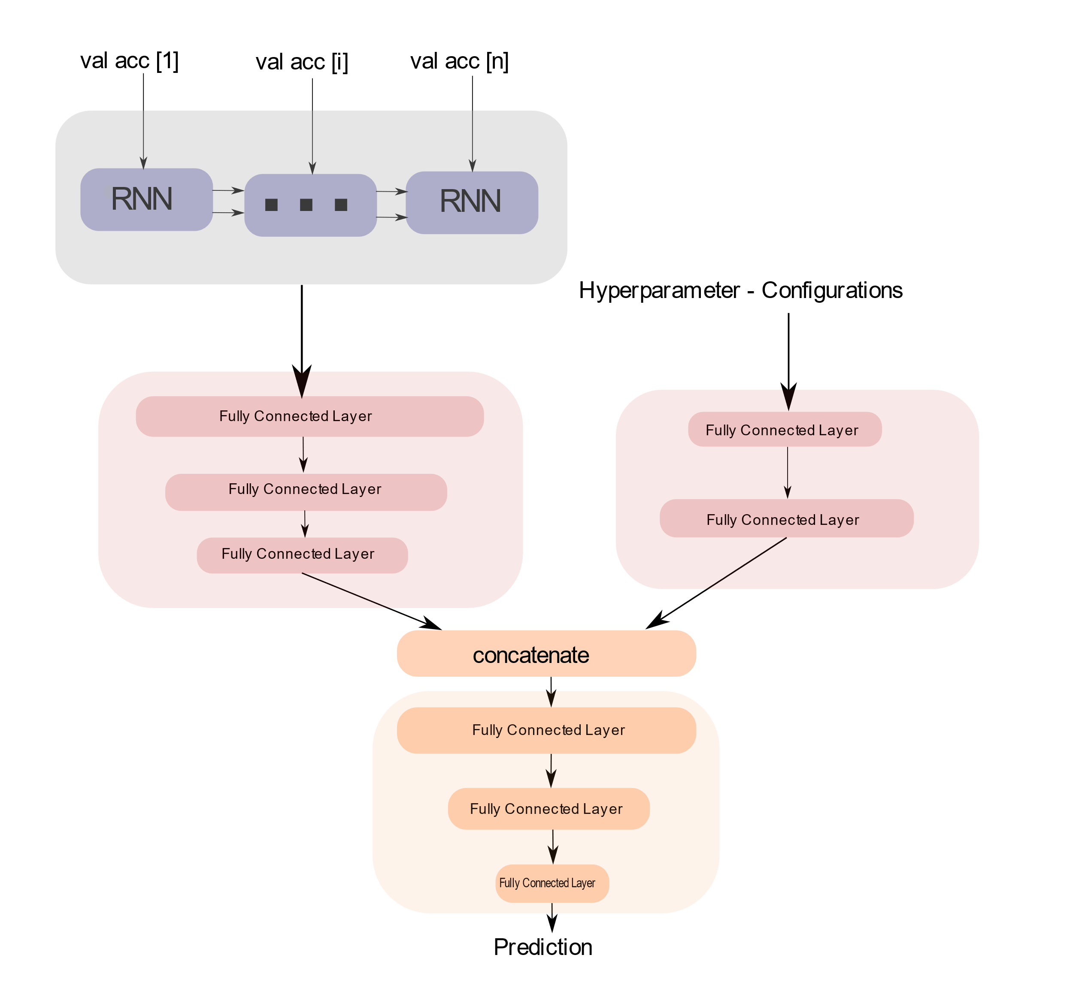
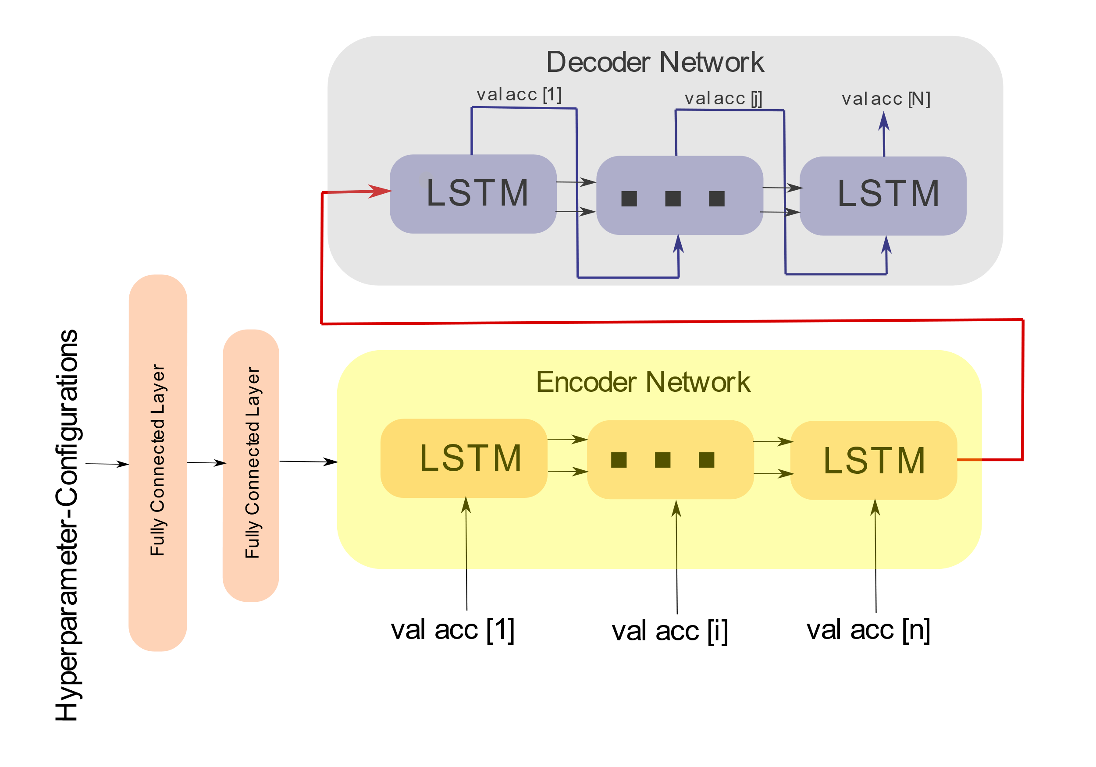
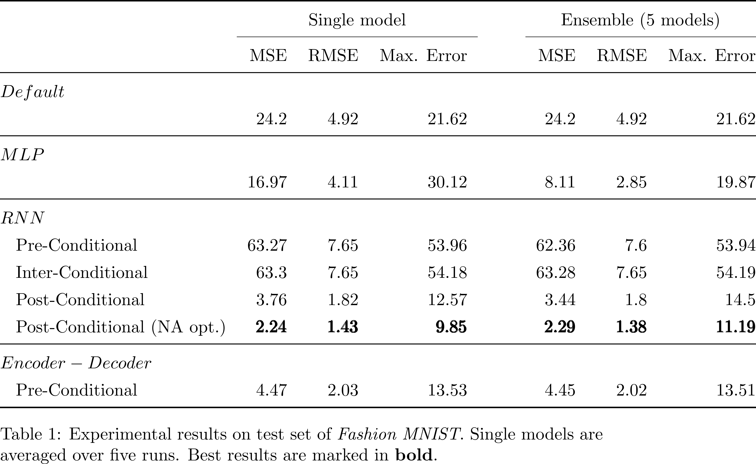
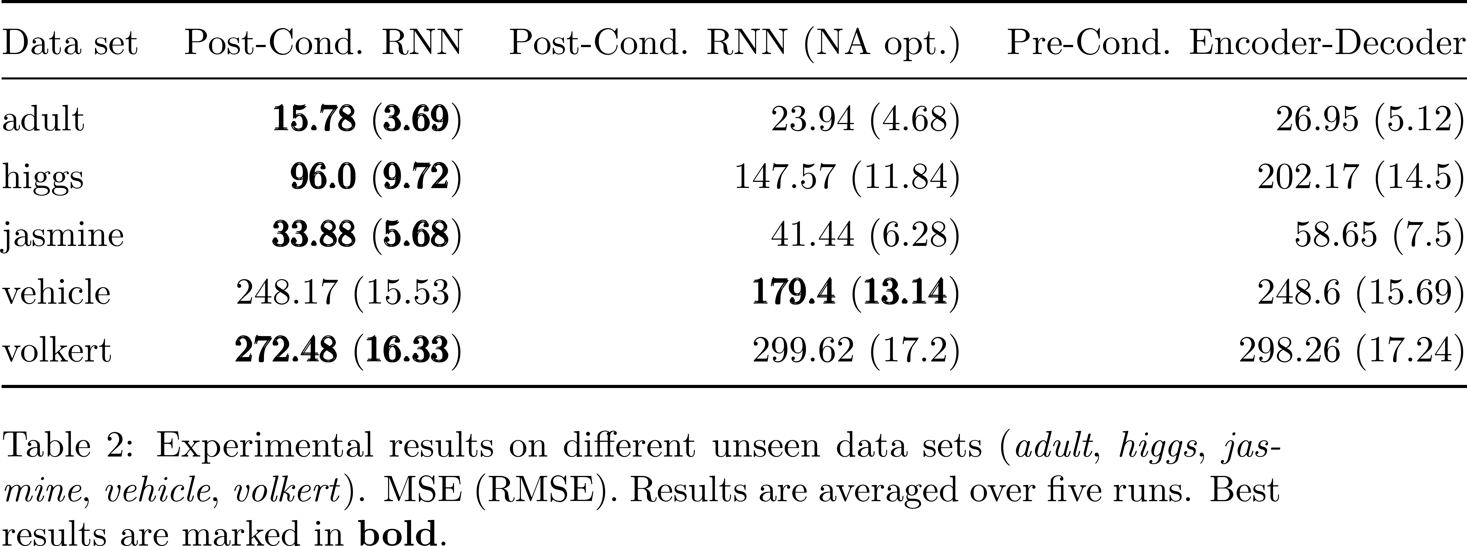
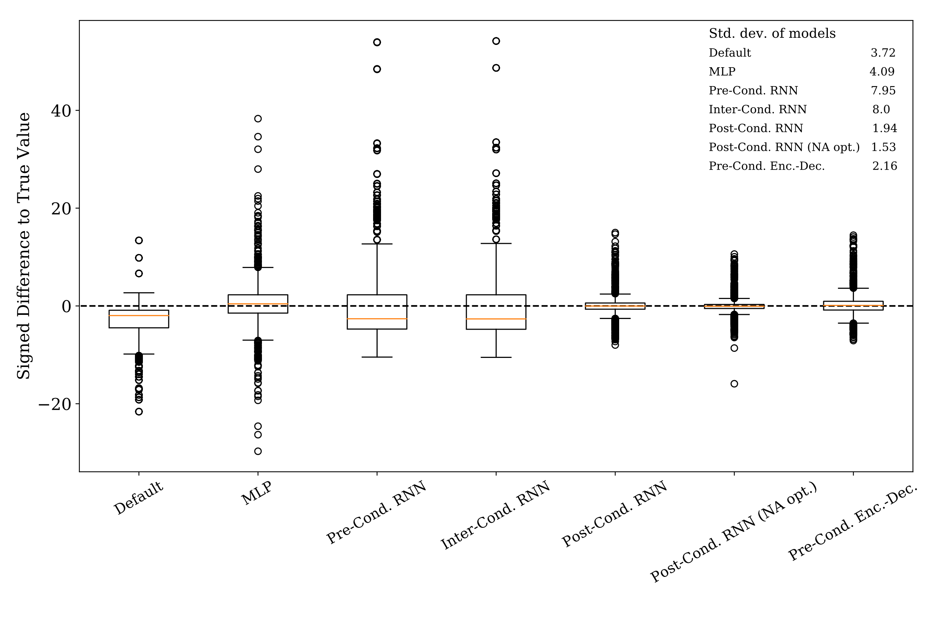
Conditional Learning Curve Models Sven Hauns, Sambit Mohapatra & Simon Schrodi
Project goals
Predict validation accuracy at the end of training
Leverage hyperparameter & sequential data information
Provide reliable predictions (e.g. final validation accuracy or total learning curve)
Evaluate generalization capability of best models
Related Work
Probabilistic rollouts, treating learning curves as sequential data & using partially observed learning curves and hyperparameters as input (Gargiani et al. 2019)
Compute embedding of condition variables (e.g. hyperparameters) & set them as the initial hidden state of the RNN (Karpathy et al. 2015, Vinyals et al. 2015)
Architectures
Pre-Conditional Encoder-Decoder RNN
Post-Conditional RNN
Experimental Results
Outlook & Future Work
Improve generalization capability of models (-> transfer learning)
Visualizing relevancies of hyperparameters
Use of multivariate sequential data input
Estimate upper and lower bounds of validation accuracy
Being Bayesian on the outputs of the model (e.g. DNGO regression model, Snoek et al. 2015)

